Slide 1
MGNT 5506GA f Strategic Management for Competitive Advantage
Jingyu (Sissi) Li

Slide 2
Objectives for Today
What are competitive advantages from the Inside?
What are resources and capabilities?
How to evaluate whether a capability is a core competency?
How to create competitive advantage through value chain activities

Slide 3

“The greatest achievement of the human spirit is to live up to one's opportunities and make the most of one's resources.”
- - Marquis de Vauvenargues

Slide 4
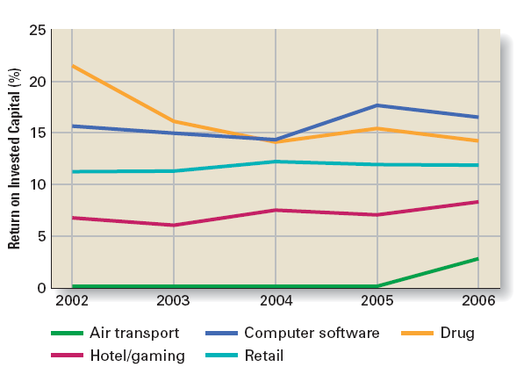
Why Internal Analysis
Recap: What Have We Learned from External Analysis?
What can external analysis tell us?
What can’t external analysis explain?
In the same industry, why do some firms perform better than others?
For example: Starbucks vs. Costa Coffee; Uniqlo vs. Esprit
Profit Rates Differ Between Firms:
20–40% of the difference comes from industry effects
55–80% comes from firm-specific factors
Internal analysis is necessary

Slide 5
Competitive Advantage
Competitive Advantage
When a company’s profitability is greater than the average of all other companies in the same industry & competing for the same customers
That is, the firm implements its positioning strategies better than rivals with the same strategies
Sustained Competitive Advantage
When a company’s profitability is maintained at above average levels for a number of years
Or, the firm is able to consistently outperform its rivals with the same positioning strategies

Slide 6
The Resource Based Model
Building sustained competitive advantage
Core competence
A source of sustained competitive advantage
“…firm-specific strengths that allow a company to differentiate its products from those offered by rivals, and/or achieve substantially lower costs….”
VRIN
Capability
An integrated set of resources;
A firm’s skill in using its resources to create goods and services.
Resources
The inputs that firms use to create goods and services
Undifferentiated or firms-specific
Tangible or intangible:
Easy to acquire or difficult to get

Slide 7
The Four Criteria of Sustainable Advantage
Valuable
Sustainable Advantage
Rare
Costly-to-Imitate
Help a firm neutralize threats or exploit opportunities
Non-substitutable
Are not possessed by many others
Historical: A unique and a valuable organizational culture or brand name
Ambiguous cause: The causes and uses of a competence are unclear
Social complexity: Interpersonal relationships, trust, and friendship among managers, suppliers, and customers
No strategic equivalent
Firm-specific knowledge
Organizational culture
Superior execution of the chosen business model

Slide 8
ARE THE FOLLOWING SKILLS CORE COMPETENCIES?
WHY OR WHY NOT?

Slide 9


Slide 10
In-class exercise: Build to Win
You are the CEO of a startup in the smart wearables industry. You’ve just received $5 million in funding.
Your goal: make strategic decisions that lead to sustained competitive advantage.
Round 1: What to Build First?
Proprietary AI health-coaching algorithm
Celebrity co-branding
Acquire a fitness app
Hire a marketing team

Slide 11
In-class exercise: Build to Win
Round 2: Go-To-Market Strategy
Go direct-to-consumer with tight integration
License algorithm
Bundle with premium content
Enter global markets
Round 3: Post-Traction Growth Path?
Invest internally to deepen your sensor and analytics technology
Outsource production
JV with global sportswear brand
Launch a budget version

Slide 12
In-class exercise: Build to Win
Round 4: Internal Structuring
Align incentives across teams to algorithm adoption and user retention
Keep R&D separate
Let teams chase independent revenue
Let branding lead
Round 5: Internal Structuring
Build a proprietary OS to unify wearables and health data
Expand into other smart product lines
License AI to third parties
Launch IPO, extend brand

Slide 13
In-class exercise: Build to Win
Round 5: Internal Structuring
Build a proprietary OS to unify wearables and health data
Extends the core resource into a platform
Adds network effects, switching costs, and ecosystem control
Enhances all four VRIN dimensions — especially N (non-substitutability)
Expand into other smart product lines: Good for growth, bad for focus
License AI to third parties: Quick revenue, long-term erosion of rarity
Launch IPO, extend brand: Focus shifts from strategy to storytelling; resources get spread thin
VRIO Insight: Scaling should reinforce your uniqueness — not replace it with scale for its own sake.

Slide 14
Build to Win: Summary
VRIO Dimension | Embedded in These Choices
Valuable (V) | Round 1 – Choose a resource that creates true value
Rare (R) | Round 1–2 – Not just rare in technology, but rare in application
Inimitable (I) | Round 2–3 – Deepening & integration make resources hard to copy
Non-substitutable (N) | Round 3–5 – Avoiding paths where other firms can offer close substitutes
Organized (O) | Round 2–4 – Aligning the value chain around the core resource

Slide 15
In-class exercise: Build to Win
Round 1: What to Build First?
Proprietary AI health-coaching algorithm
Valuable: Delivers personalized experiences and improves health outcomes
Rare: Few startups have a proprietary, adaptable AI engine
Inimitable: Especially if trained with proprietary, evolving data
Non-substitutable: Alternatives exist, but not at the same depth
Celebrity co-branding: easy to imitate, not rare or inimitable
Acquire a fitness app: User base may be valuable, but engagement is substitutable and easily lost
Hire a marketing team: Tactical advantage, not a strategic resource
VRIN Insight: The right resource is not just popular or visible: it needs to be embedded, hard to copy, and scalable.

Slide 16
In-class exercise: Build to Win
Round 2: Go-To-Market Strategy
Go direct-to-consumer with tight integration
Aligns value capture with your unique resource
Allows you to own the user experience and data loop
Reinforces O (Organized) by embedding tech in operations and brand
License algorithm: Monetizes quickly but surrenders control; Weakens inimitability
Bundle with premium content: Looks appealing, but margins shrink; Core resource is diluted
Enter global markets: Too early — risks spreading organization thin before advantage is consolidated
VRIN Insight: Organizing around your resource is more important than speed or scale. Control > exposure.

Slide 17
In-class exercise: Build to Win
Round 3: Post-Traction Growth Path?
Invest internally to deepen your sensor and analytics technology
Reinforces core capability
Increases complexity and barriers to imitation
Deepens your "I" and "N" dimensions, especially when aligned with usage data
Outsource production: Reduces costs, weakens control, and standardizes your uniqueness
JV with global sportswear brand: Access to channels, cedes control, and dilutes identity
Launch a budget version: Trades differentiation for volume — erodes rare/inimitable status
VRIO Insight: The most dangerous moment is when you’re tempted to scale fast. Advantage must be fortified, not diluted.

Slide 18
In-class exercise: Build to Win
Round 4: Internal Structuring
Align incentives across teams to algorithm adoption and user retention
Creates cross-functional synergy
Ensures your unique capability is being used and evolved across the value chain
Classic example of "O" — Organized to exploit
Keep R&D separate: Agile but disconnected from value delivery
Let teams chase independent revenue: Fragmented, resource loses strategic centrality
Let branding lead: Branding is important, but cannot substitute for deep integration with core tech
VRIO Insight: A strategic resource fails if the firm is not designed around it. Misalignment = wasted potential.

Slide 19
In-class exercise: Build to Win
Round 5: Internal Structuring
Build a proprietary OS to unify wearables and health data
Extends the core resource into a platform
Adds network effects, switching costs, and ecosystem control
Enhances all four VRIN dimensions — especially N (non-substitutability)
Expand into other smart product lines: Good for growth, bad for focus
License AI to third parties: Quick revenue, long-term erosion of rarity
Launch IPO, extend brand: Focus shifts from strategy to storytelling; resources get spread thin
VRIO Insight: Scaling should reinforce your uniqueness — not replace it with scale for its own sake.

Slide 20
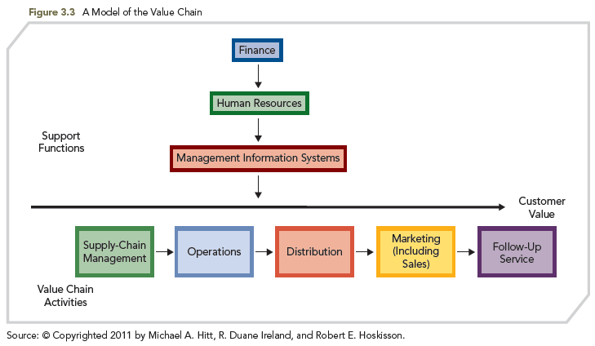
Value Chain Analysis
“…company is a chain of activities for transforming inputs into outputs customers value – including primary & support activities.”
Allows a firm to understand the parts of its operations that create value and those that do not
Definition: A template that firms use to understand their cost position
Identify multiple means that might be used to facilitate implementation of a chosen business-level strategy

Slide 21
Value Chain Activities
Primary Activities
Activities the firm completes in order to produce products and then sell, distribute, and service those products in ways that create value for customers
Support Functions
Activities the firm completes in order to support the work being done to produce, sell, distribute, and service the products the firm is producing

Slide 22
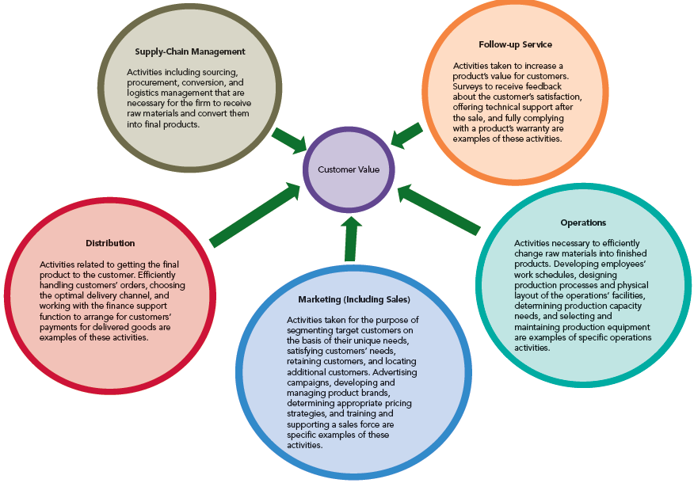
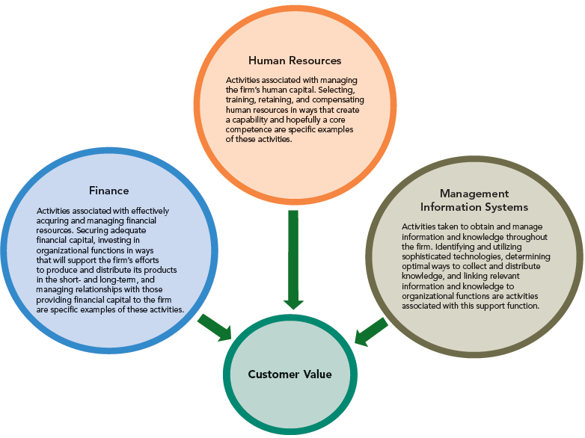
Primary Activities vs Support Functions

Slide 23
What should a company do if it cannot create sustainable competitive advantages from any single resource, capability, or value chain activity?

Slide 24
From VRIN to VRIO
O: Organization/organized
The unique pattern or business model can become the source of sustained competitive advantages.
How firms organize their resources and capabilities is critical.
The entire value chain can be difficult to imitate or substitute.
Firm Infrastructure (General Management)
SUPPORT ACTIVITIES
Human Resource Management
Customer Value
Technology Development
Margin
Procurement
Inbound Logistics
Ops.
Outbound Logistics
Sales & Marketing
Service and Support
Margin
Customer Value
PRIMARY ACTIVITIES

Slide 25
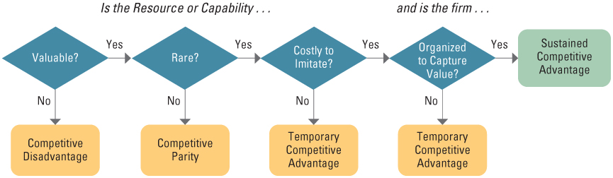
Applying the Resource Based View

Slide 26
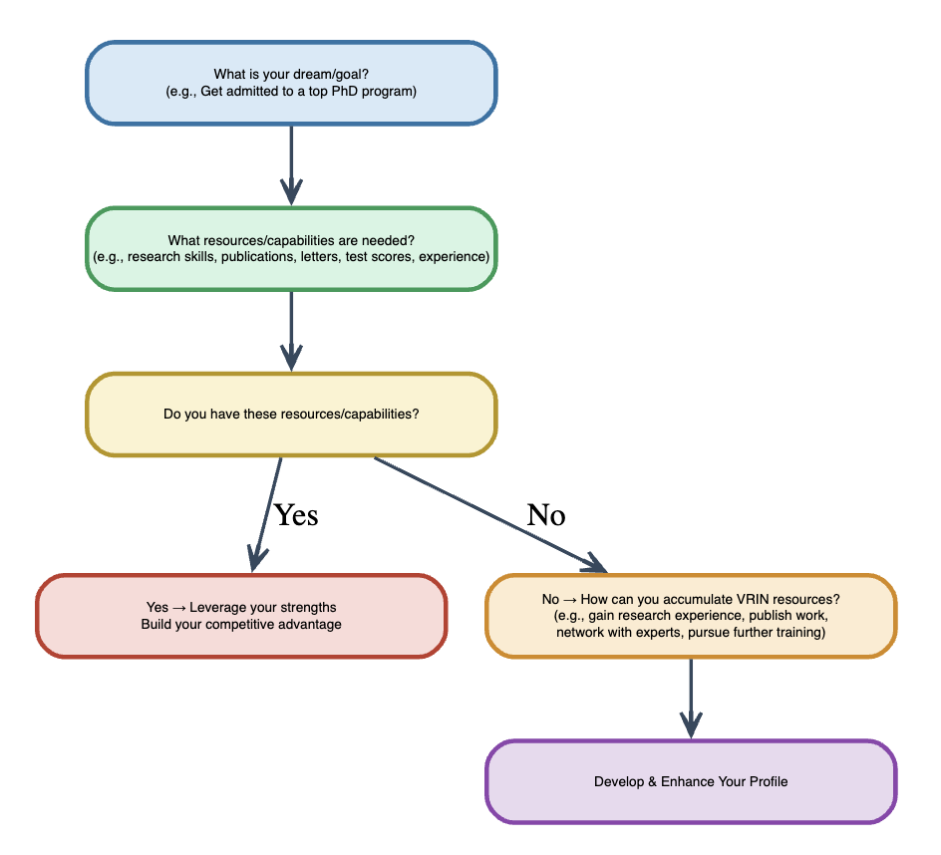
Applying the internal analysis to your life planning

Slide 27
Class Exercise: Job Interviews
Context:
You are preparing an interview at a prominent management consulting company for the position of business analyst
Rules:
You will have 5 minutes to prepare a self-statement
You need to read the job description (next slides) carefully to identify the addressed attributes and capabilities
You need to emphasize the following points in your self-statement
What resources (i.e., training, experiences, etc.) do you have that can meet the company's requirements
How do these resources contribute to building you any capability that may be attractive to the company
How can you outperform others?

Slide 28
Class Exercise: Job interview
Job description
Work in teams to identify and implement potential solutions for a specific client problem or challenge. Help clients make lasting improvements to their performance and realize their most important goals.
Gather and analyze information, formulate, and test hypotheses, and develop and communicate recommendations.
Present results to client management and implement recommendations in collaboration with client team members. Travel to your client site.
Receive training and coaching on:
Structure ambiguous problems and take action to solve them
Synthesize clear takeaways from complex information into clear takeaways and recommendations using both qualitative and quantitative methods
Work effectively with diverse teams to identify the best solution and move people and organizations to act
Establish trust-based relationships with clients to better serve their organizations.
Communicate effectively with all audiences, including senior leaders, in a structured manner
Serve on multiple client engagements and work with a number of colleagues and clients in a range of industry and functional areas.
Rotation with one of our practices (e.g., corporate finance, social sector, healthcare, operations) or global offices. Intersect with many elements of work including digital, implementation, and tech and analytics capabilities –by collaborating on teams or working with colleagues from these group.
Source: McKinsey

Slide 29
Class Exercise: Job interview
Presentation
Five volunteers or victims lucky students will be selected as the shortlisted candidates
Each student needs to present his/her statement to the whole class
Each presentation is limited to 3 minutes
The goal of this presentation is to get the job
The remaining students are the interviewers who need to vote for their preferred candidate
Interviewers can ask questions
Sissi is the head of the HR department who can make the final decision
Who will be the final winner?

Slide 30

To gain competitive advantage, firms must build distinctive competencies in the form of Resources and Capabilities
Competitive advantage can be sustained through strategies linked to unique resources (VRIN framework)
Successful management of value chain can help firms gain sustained competitive advantages
Outsourcing is an effective tool, if pursued with the correct conditions and reasons

Slide 31

Why does Aldi Succeed

Slide 32

Case Analysis: Aldi
What makes Aldi so low cost?
Limited assortment:
Economies of scales:
Reduced averaging fix costs
Stable logistics
Increase bargaining power with certain suppliers:More committed suppliers
Stable products:
Limited selection for each product
Economies of scales
Easier for customers to choose: saving time
Private label
Cheaper: low packaging and ads fees
Own brand: High power in selecting suppliers
Good reputation for quality: Fix investment to lock people in
Barcode on the side: Aldi’s design, easy to find, Not fancy

Slide 33
Case Analysis: Aldi
What makes Aldi so low cost?
Special buys
Sells out quickly
Self-promotion items
Lower inventory and inventory management costs
Only takes the shelve space when on sale
Builds up traffics for other stuff
Win Aldi powerful position against the suppliers of those special buys
Aldi can decide when and whether to do the special buy
Lower negotiation cost: suppliers will know Aldi can only accept low price
Suppliers can plan in ahead to fit unused capacity
Bare bones store:
No music, little decoration, cheap light
Save costs and labor
Attract the right customers
Reduce shopping time: smaller space with smaller parking lot

Slide 34
Case Analysis: Aldi
What makes Aldi so low cost?
Coin deposit for carts
Saves labor costs
Reduce the likelihood of damaging carts or carts damaging cars
Save parking space
Customer DIY
Return carts; open boxes when run out; do you own bagging
Customer education
Fast through the stores:
Special design: No entertainment & No decoration
Can serve more people within limited space
Late introduction of Techs: Credit card & scanner etc…
Save money for equipment and labels
Can do so because it is more efficient than other stores

Slide 35
Case Analysis: Aldi
What makes Aldi so low cost?
Store itself is the storage: save costs and labor
Saved labor costs:
Fewer employee per store
Centralized pricing and assortment decision
One employee per store is barely enough
Organizational culture
Low cost
Efficiency
Everyone knows the goal: lower the price through maximal simplicity
What is Aldi’s Value proposition?
They will sell you the cheapest products if You are willing to buy private brand products in a bare bone store where you need to do lots of the work by yourself.

Slide 36
Case Analysis: Aldi
How does Aldi manage its industry stakeholders?
Aldi’s customers:
Lower incomed people
People who are used to or like Aldi’s way of shopping
People who like Aldi’s private brands
Bargaining power of Aldi’s customers: Relatively low
Cannot get the price and private brand elsewhere
High switching costs
Who are Aldi’s suppliers?
Private brand product producers & Special buy producers
Bargaining power of Aldi’s suppliers: Relatively low
Aldi buys in a bulk
Aldi owns its own brand name
Aldi can offer stable orders
Win Aldi powerful position against the suppliers of those special buys

Slide 37
Case Analysis: Aldi
Aldi’s substitute:
General brands
Much more costly
No close substitution for private brand products
Competitive analysis
Should Walmart be worried about Aldi in the U.S.?
Yes?
Both company share similar core value: Low cost
May compete for customers;
Aldi can Hurt Wal-Mart’s brand image
Aldi is expanding in the U.S.
Aldi’s Special buys: direct competition with Wal-Mart.
Aldi has beaten Wal-Mart in German
Aldi is more suitable for smaller towns and crowded cities
Aldi’s private brand products are exclusive

Slide 38
Case Analysis: Aldi
Should Walmart be worried about Aldi in the U.S.?
No?
Different market segments: private brand vs. general brand
Walmart offer much more things: grocery is only a small portion of its business
Walmart can fight back easily
Should Aldi be worried about Walmart in the U.S.?
Yes?
Aldi attacks Walmart’s core value proposition: Walmart will react
Walmart can use its massive scale to crush Aldi
Walmart will react sooner to prevent Aldi from growing too big
Home country advantage (generally and politically)
No
Aldi has lower price
Per SKU basis, Aldi has 10 times the scale of Walmart
Once customers are get used to Aldi format, they will stay
A price war is more costly to Walmart

Slide 39
Case Analysis: Aldi
Should Aldi come to Hong Kong? Why?
Should ParknShop be worried about Aldi if Aldi comes to Hong Kong?

